Slide 1
Balancing Notes

Slide 2
Software
Open DigiVibeMX
Make sure device is connected
Make sure windows is not listening to device as microphone input

Slide 3
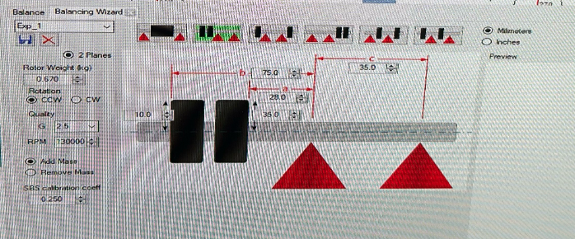
Balancing Wizard
Use wizard to define system
System goes left to right
This would be opposite for example setup in following pictures
Mass 2
Mass 1
Plane 1
Plane 2

Slide 4
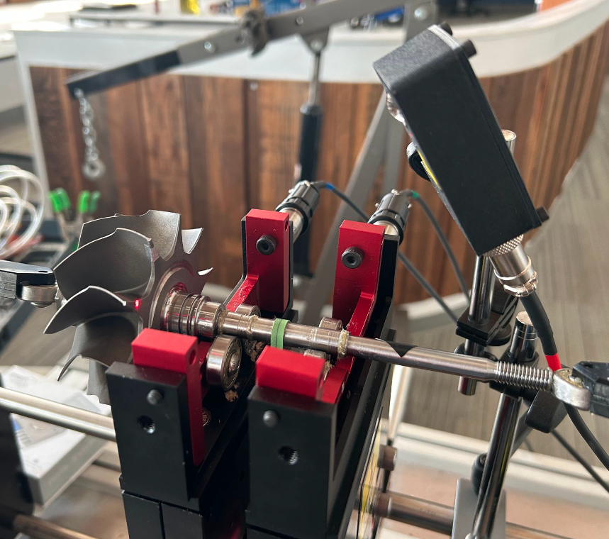
Physical Setup
Ideally, optical sensor should be in same orientation as accelerometers and greater than 6 inches away
Verify trigger spinning by hand

Slide 5
Orientation
0 degrees
Spin direction is from ACC 1 looking into assembly.
CCW in this case
Mass subtraction/addition will be in spin direction relative to optical pickup
ACC 1
90 degrees

